Slide 1

P peline
The Data
Byte 3
© Jennifer Mankoff & Nikola Banovic
The Data Pipeline; HCII; Spring 2017

Slide 2
Byte 3
So you are done collecting your data.
Now what?

Slide 3
The Architecture Revisited
Google Cloud Platform

Slide 4
The Architecture Revisited
GCP
Appspot
SHELL
deploy
Dev
DB
Notes:
So far we used the shell to develop our apps, to test in dev server, and to deploy to the Appspot.

Slide 5
The Architecture Revisited
GCP
Appspot
PUBLIC
SHELL
deploy
Dev
DB
YOU
Notes:
And you were able to view your application on both. And public was able to see it on the app spot.

Slide 6
The Architecture Revisited
GCP
Appspot
PUBLIC
SHELL
deploy
Dev
DB
API.AWARE
YOU
Notes:
And then we introduced your phone, which communicated with api.awareframework.com to move the data to your GCP database. This is where you are now.

Slide 7
The Architecture Revisited
GCP
Appspot
PUBLIC
SHELL
deploy
Dev
DB
API.AWARE
YOU
Notes:
Now the goal is to create an application that uses the data from the DB.
You will still develop on your shell. However, you will not be able to view the app on your dev server! This is too difficult to configure and we will not ask you to do this.

Slide 8
The Architecture Revisited
GCP
Appspot
PUBLIC
SHELL
deploy
Dev
DB
API.AWARE
YOU
Notes:
Instead, you will deploy directly to appspot and test there because appspot has an ability to access the DB.

Slide 9
The Architecture Revisited
GCP
Appspot
PUBLIC
SHELL
deploy
Logging
Dev
DB
YOU
Notes:
And you will use GCP logging services (that you already tried in Byte 1) to debug your application.

Slide 10
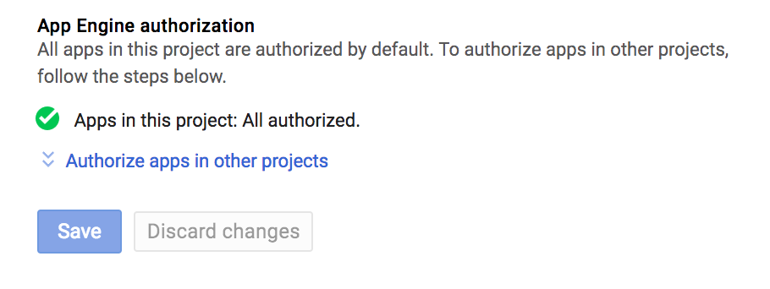
Communicating with the database
You application needs access to DB!
This is usually automatic, but I saw examples where it did not happen. You need to add your Application ID in your ”Access Control” if you do not see this:
Notes:
Otherwise just click on authorize apps and add your Application ID.

Slide 11
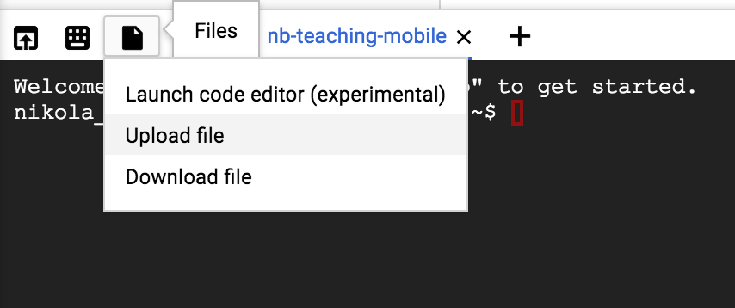
Developing Code
Start by uploading jmankoff-mobile to your Shell using the upload feature in your Shell.

Slide 12
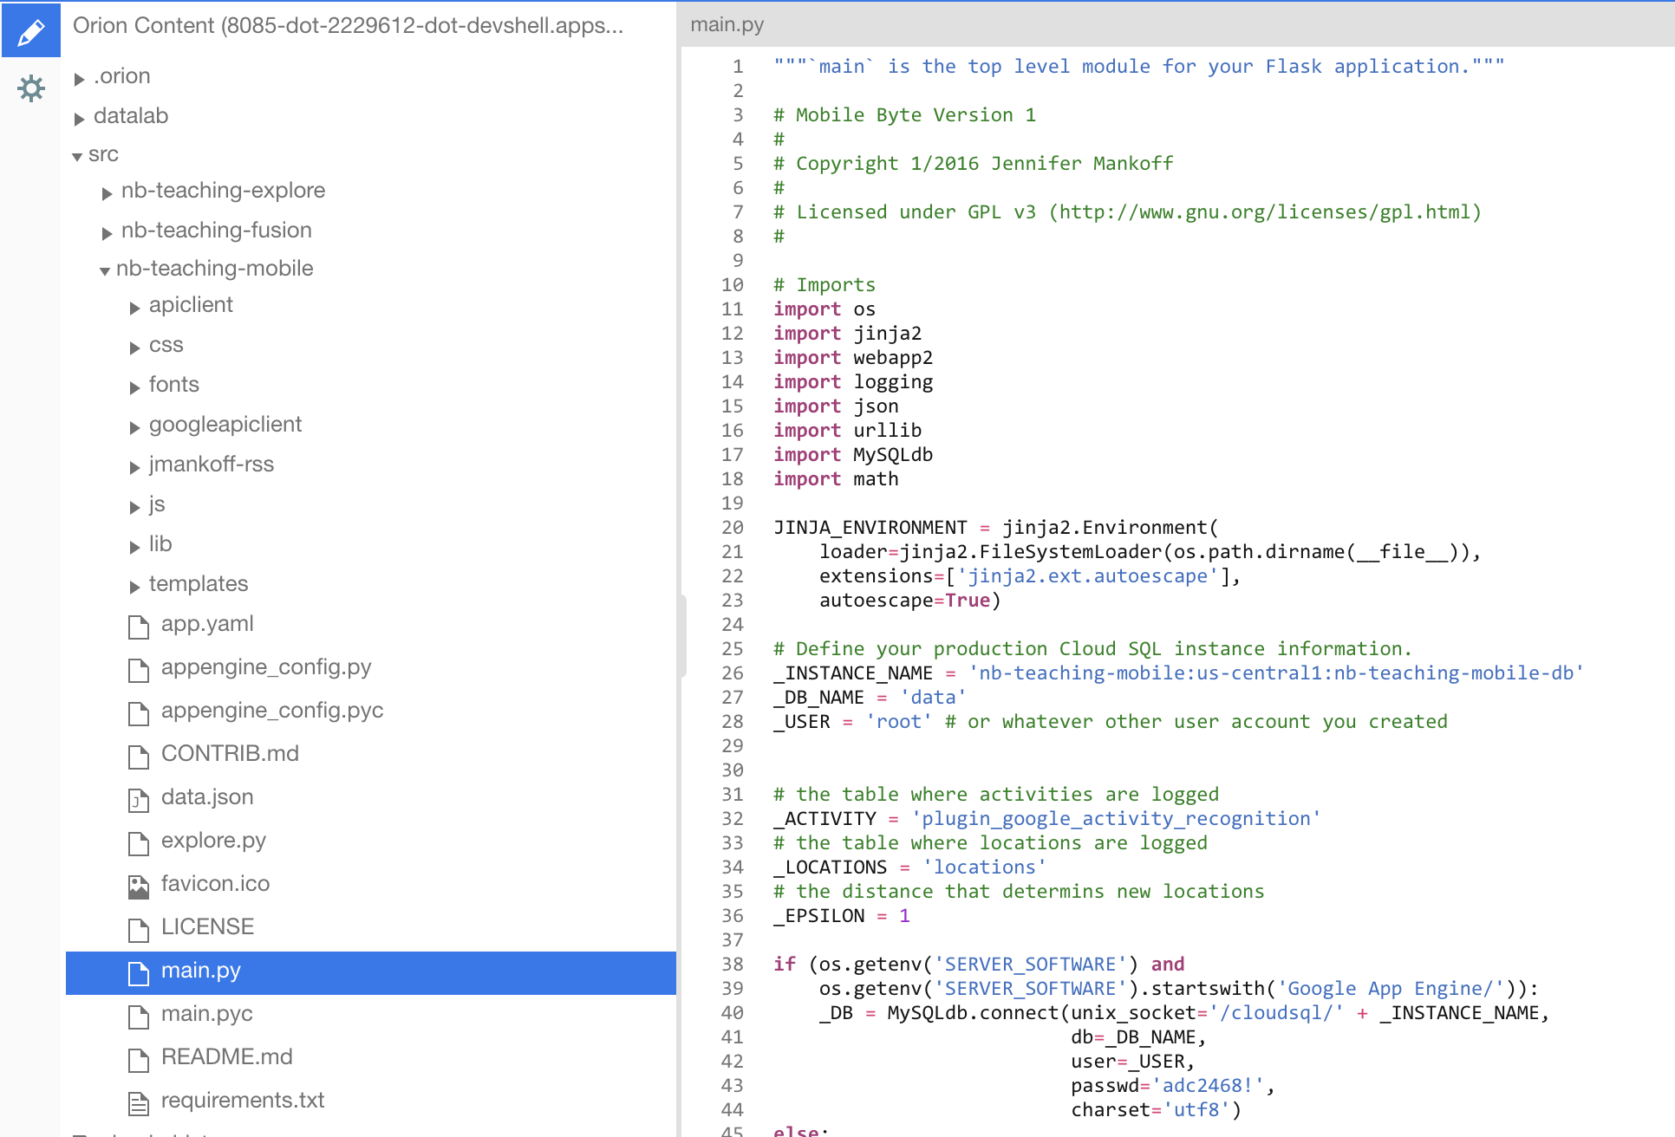
Developing Code
Once you setup the files in your document hierarchy the way you want you can start modifying the code in the Editor.

Slide 13
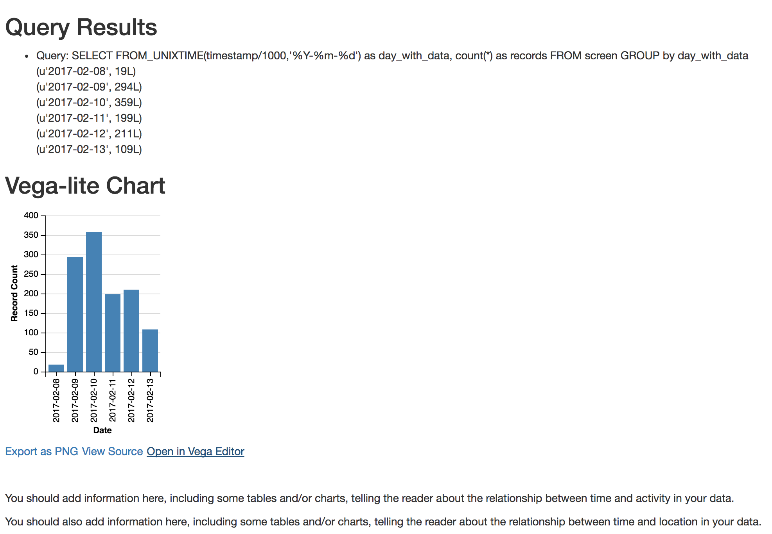
Developing Code
Deploy the code. By default, if you have location and activity data you should see:

Slide 14
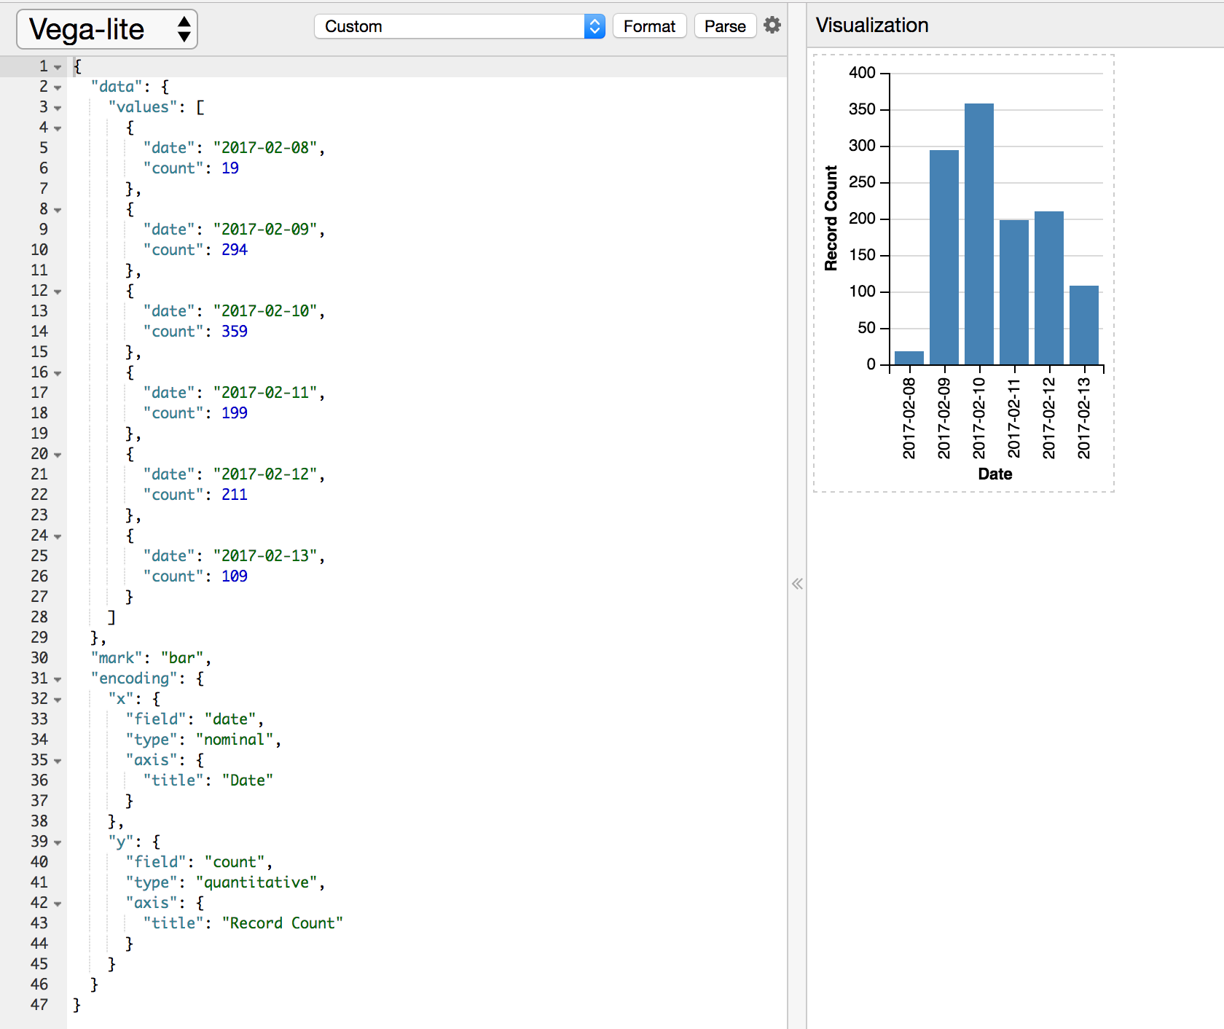
Developing Code
Vega-lite has an editor that helps you edit the JSON and see example. Click on “Open in Vega Editor” to see it.
VISUALIZATION
DATA
VISUALIZATION DEFINITION

Slide 15
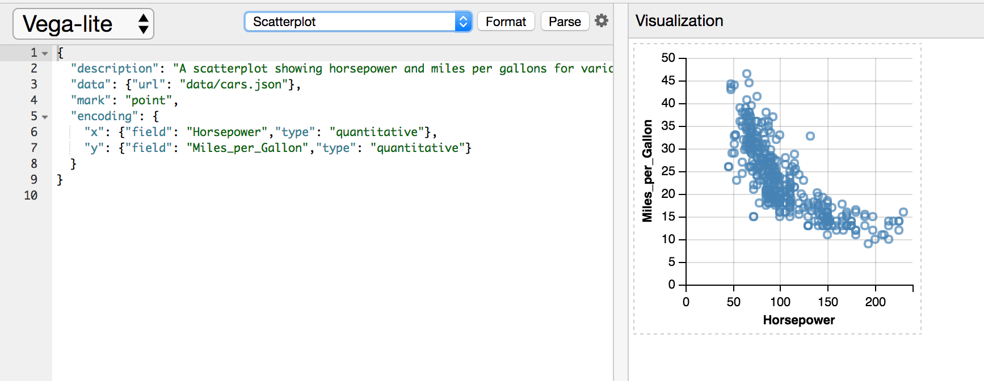
Developing Code
You can also see examples:

Slide 16
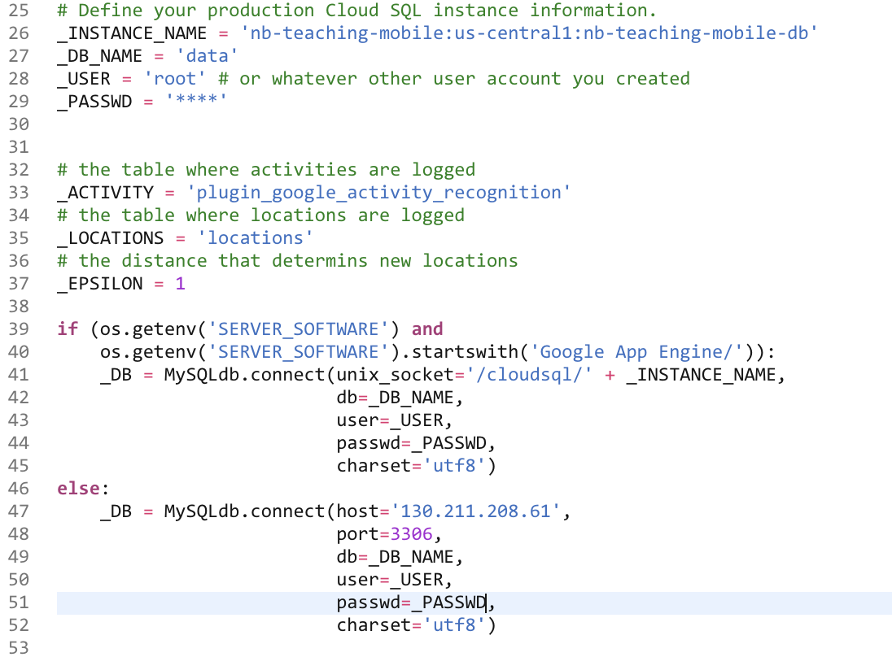
Developing Code
Connecting to the DB (main.py):

Slide 17
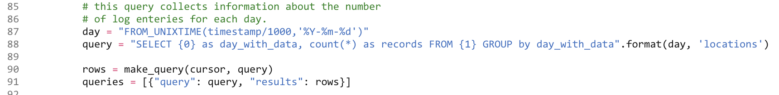
Developing Code
Making a SQL query (main.py):

Slide 18
Developing Code
Executing and passing data to the view (main.py):

Slide 19
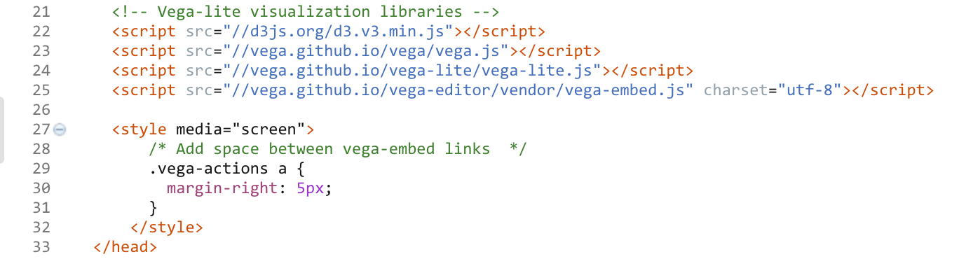
Developing Code
“Installing” Vega-lite (index.html):

Slide 20
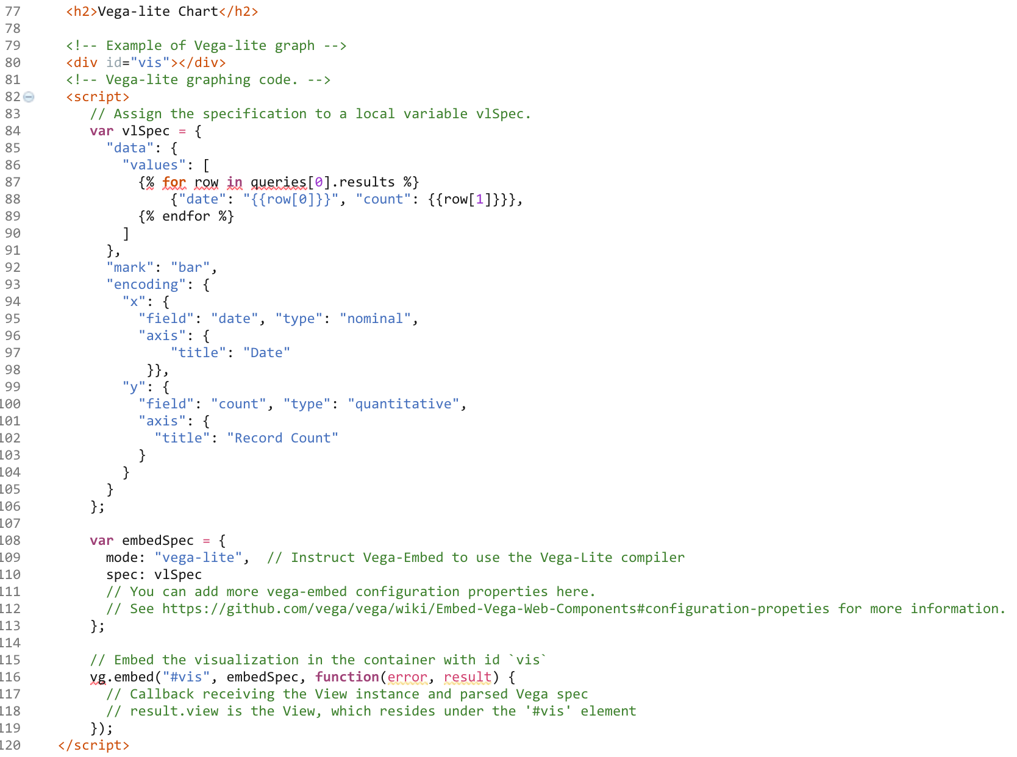
Developing Code
Displaying visualization (index.html):
<- Element to display in
<- Data and visualization specification
<- Instruct Vega-lite to display in element

Slide 21
Developing Code
If you do not like Vega-lite examples or if you don’t like changing JSON to get your chart just right, use Lyra (optional): http://idl.cs.washington.edu/projects/lyra/app/

Slide 22
Developing Code
What is MVC?

Slide 23
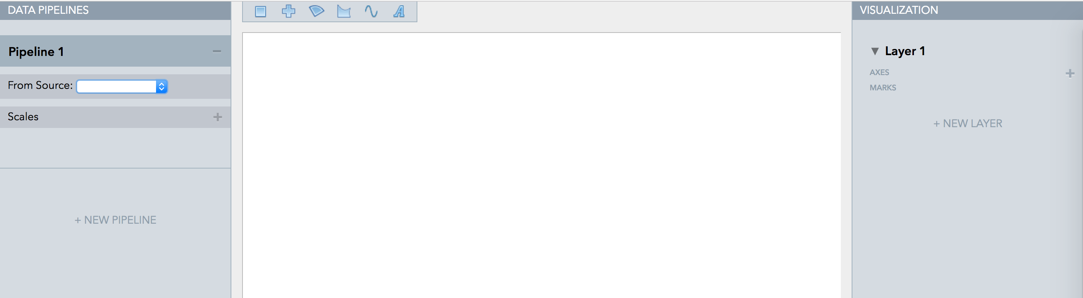
Developing Code
Lyra is an interactive environment that enables custom visualization design without writing any code.
<- Load your data source

Slide 24
Developing Code
Lyra is an interactive environment that enables custom visualization design without writing any code.
A great demo at:
https://vimeo.com/96104443

